Slide 1


Forecasting Regional Electrical Load

Slide 2

Energy is like bananas…

Slide 3
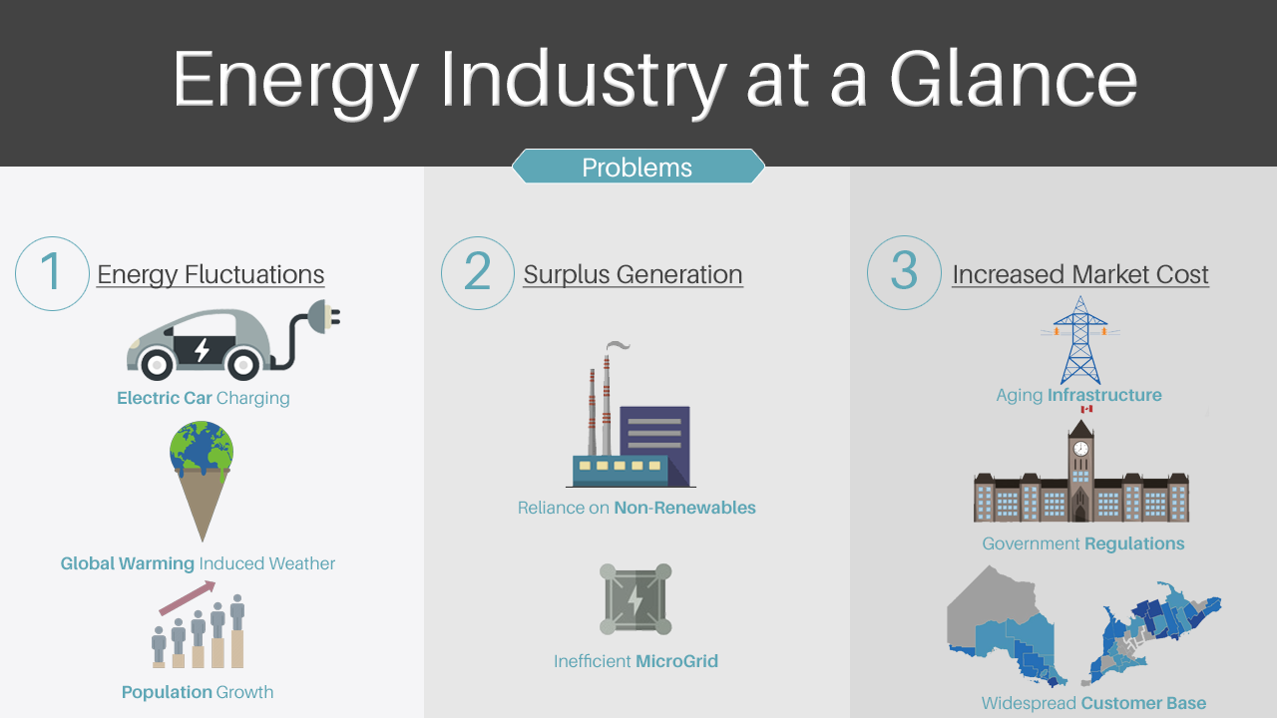

Slide 4

The Market
$6.02
$11.7
26.4
Billion
Million
Tera-Watts
Energy Market Size
Surplus Energy Generation
Electrical Imports & Exports
OPG 2019[1]
IESO 2019[2]
IESO 2019[3]
1. https://www.opg.com/reporting/financial-reports/
2. http://www.ieso.ca/en/Corporate-IESO/Corporate-Accountability/Financial-Reporting
3. http://www.ieso.ca/corporate-ieso/media/year-end-data
4. IESO – Independent Electrical System Operator
5. OPG – Ontario Power Generation
6. $ in CAD

Slide 5
Value Proposition
WE CREATED A LAYERED SOLUTION…
Use Machine Learning to analyze inputs from real historical data to learn nonlinear trends
Effective hourly climate data specific to each region to better forecast customer load
Reliable and accurate data collected from government sources
Accurate regional forecasts provided through a WebApp

Slide 6




Customers & Partners
Our customers are our partners!
Ontario Power Generation
Canada Energy
IESO
London Hydro

Slide 7
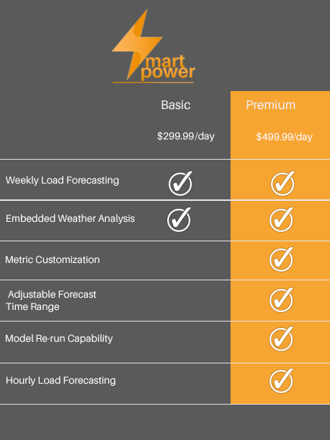

Revenue Stream
Subscription Based Model

Slide 8
Cost Model
Data Storage
Hosting the Domain
Microsoft Azure™ Subscriptions
- Cluster Management
- Node Usage

Slide 9
DEMONSTRATION
https://thinksmartpower.azurewebsites.net/

Slide 10
Ottawa Electrical Demand and SMART Power Forecast

Slide 11
Average Percentage Error for Models
3.9182
2.6874
3.1852
2.3397
Toronto
Ottawa
Bruce
IESO

Slide 12
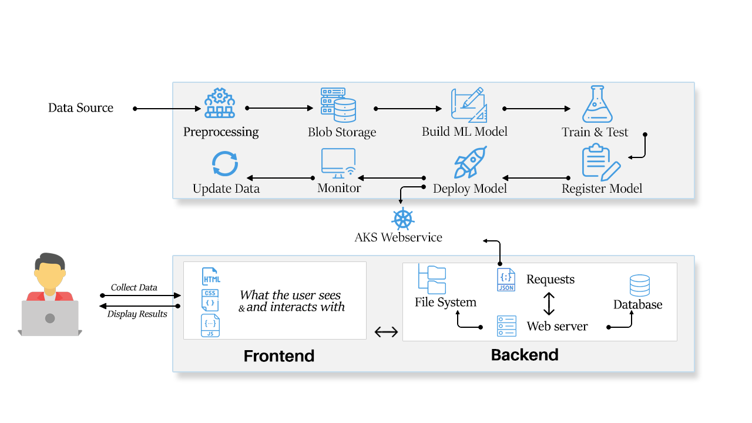
Design Architecture
ML – Machine Learning

Slide 13
Revenue | Year 1 | Year 2 | Year 3
Premium Subscriptions | $ 182,496.35 | $ 237,245.26 | $ 308,418.83
Basic Subscriptions | $ - | $ 109,135.00 | $ 130,962.00
Total Revenue* | $ 182,496.35 | $ 346,380.26 | $ 439,380.83
Projected
Income Statement
Cost of Goods
Storage Fees | $15,488 | $20,134 | $26,175
Cluster Management | $9,139 | $11,880 | $15,444
Hosting Expenses | $1,200 | $1,200 | $1,200
Total CoGS | $25,827 | $33,215 | $42,819
Gross Profit | $156,670 | $313,166 | $396,562
Operating Expenses
Marketing | $5,000 | $7,500 | $10,000
R&D | $1,500 | $1,500 | $3,000
Rent | $30,000 | $30,000 | $30,000
Wages | $105,000 | $105,000 | $105,000
SG&A | $2,500 | $4,000 | $7,000
Loan | $27,000 | $27,000 | $27,000
Interest* |  | $9,450 | $9,450
Total Expenses | $171,000 | $184,450 | $191,450
Taxable Income | ($14,330) | $114,386 | $319,497.54
Taxes* | ($459) | $3,660 | $10,224
Net Profit | ($13,872) | $110,725 | $309,274
Assumptions:
Sales*: 30% increase from year 1 to 2 and year 2 to year 3 for premium and 20% for basic
Interest*: 7% interest rate for $135k small business loan with 5 year payback period
Taxes*: 3.2% Small Business Tax Rate for first 500,000 of income

Slide 14
NEXT STEPS SCHEDULE
WebApp Domain Launch
Customer Acquisition
3 Months
2 Months
2 Months
5 Months
Automate Model Training Pipelines
Company Incorporation
12 Months to Market

Slide 15



MEET THE TEAM
ADAM DUNN
DHEERAJ GHANGAS
NATHEN GAY
Bachelor’s of Electrical Engineering
Honour’s Bachelor of Business Administration
Honour’s Bachelor of Technology Software Development

